Slide 1
Time for visualization!

Slide 2
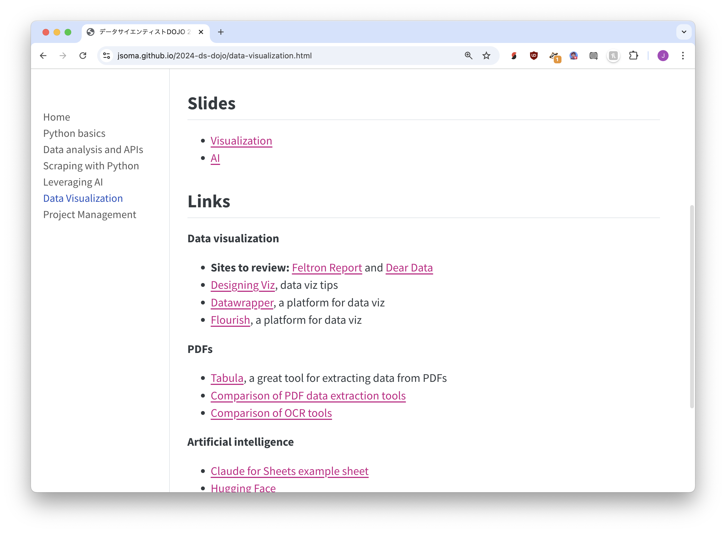
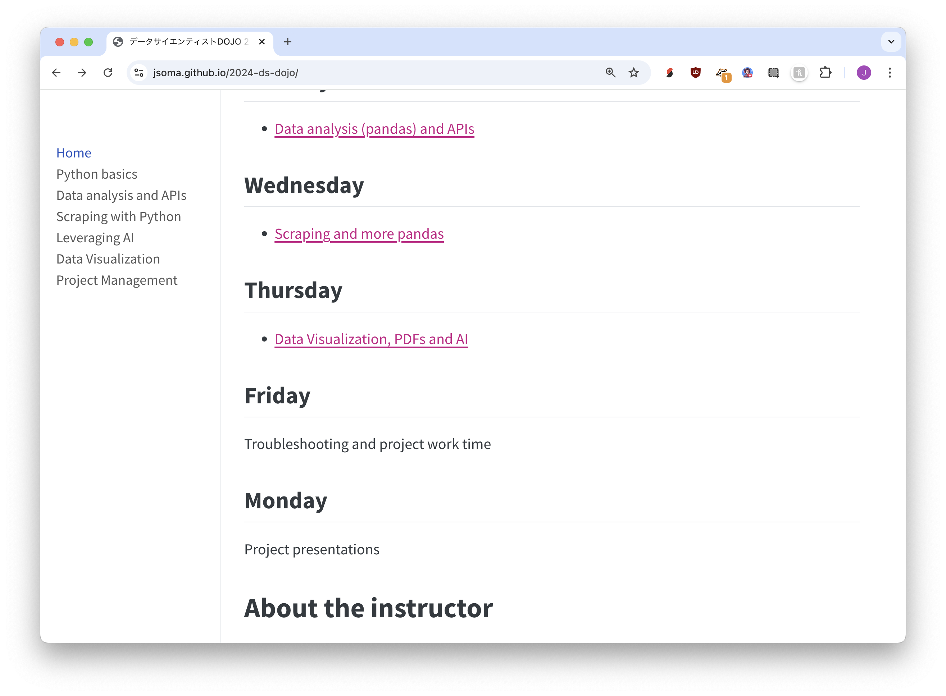



② Visit Feltron Report and Dear Data
① Visit https://bit.ly/ds-dojo-2024,
Click Data Visualization

Slide 3
Let’s talk about communication through design

Slide 4
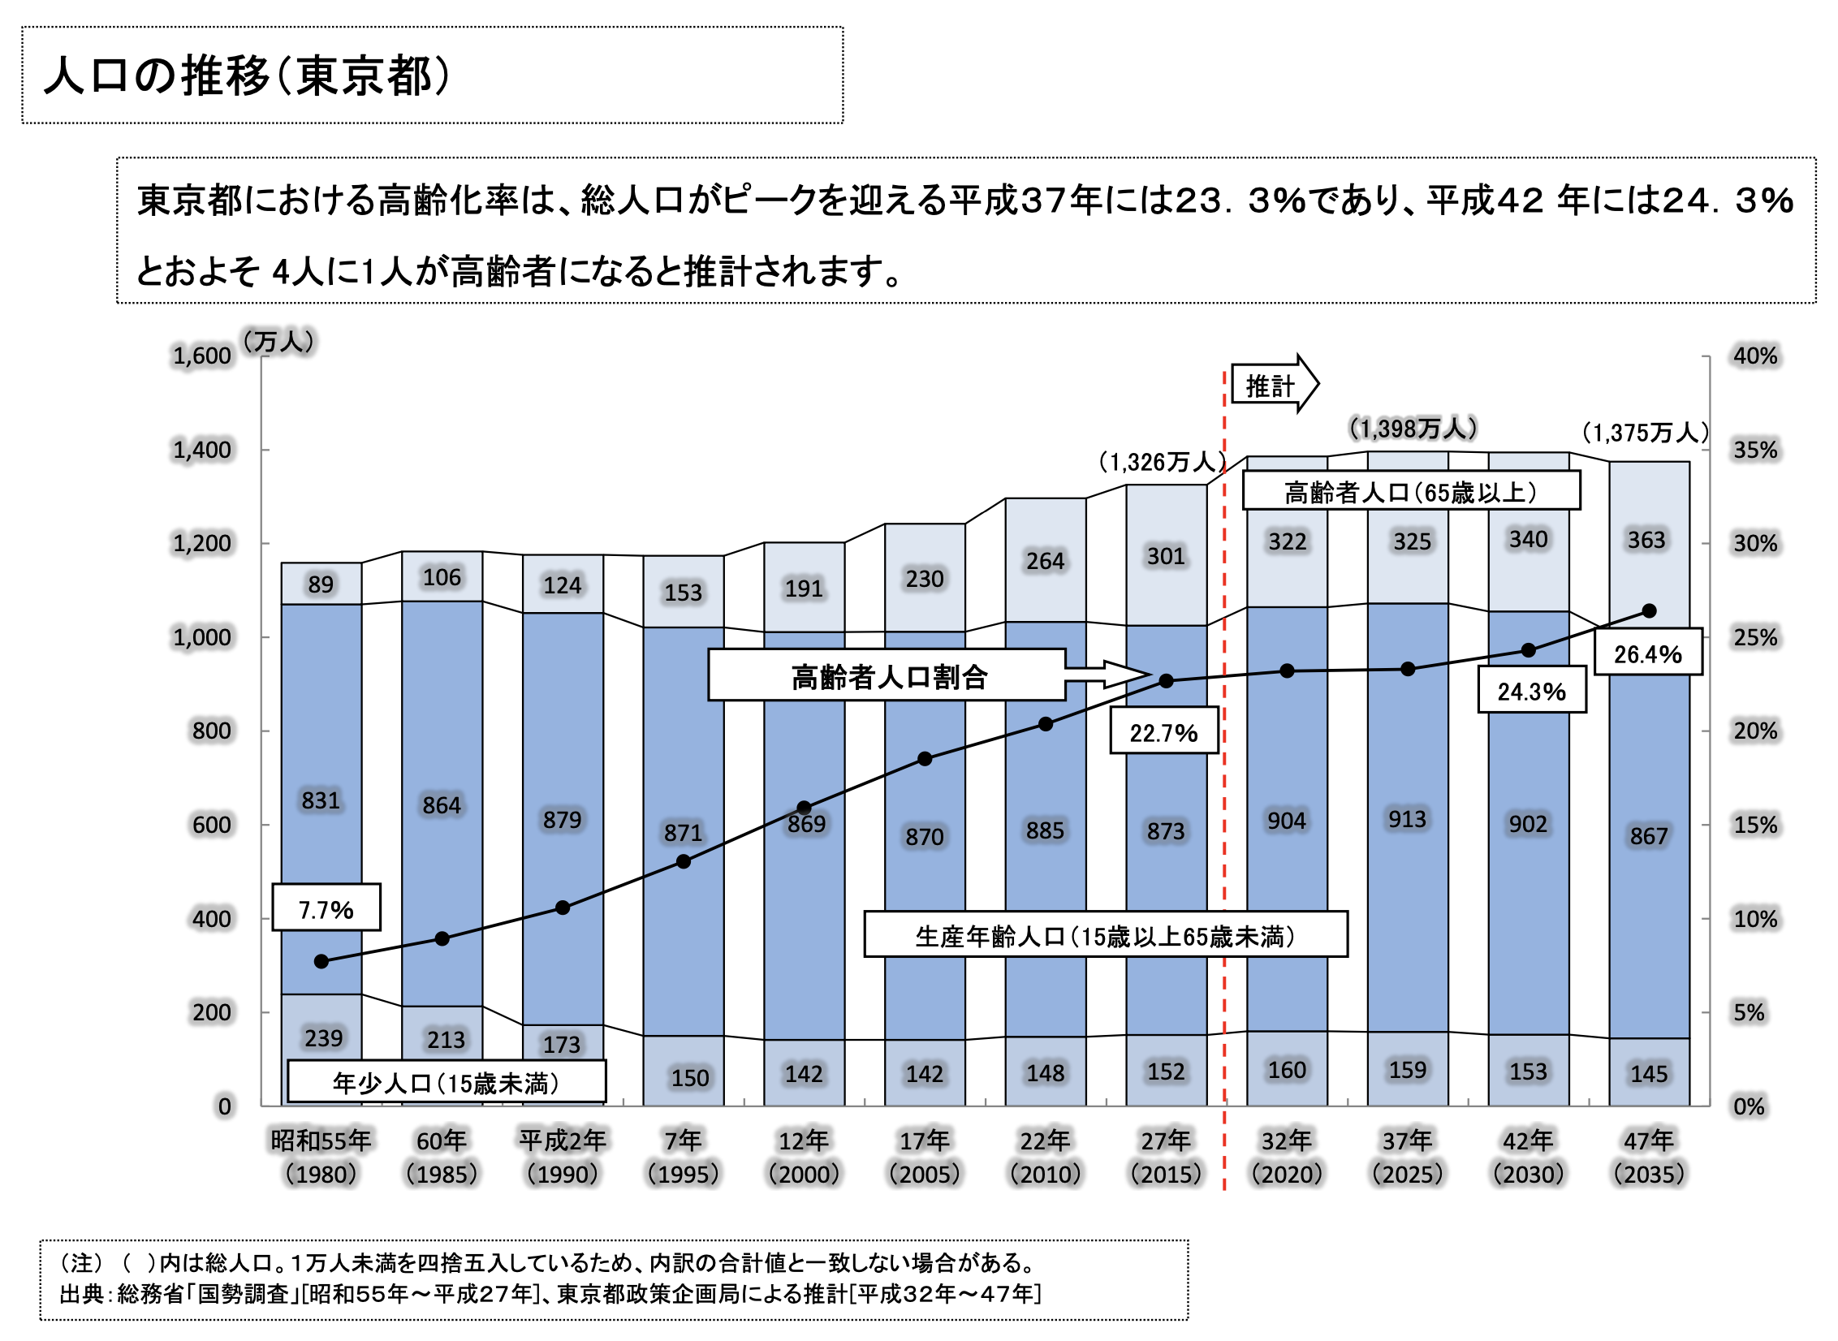

Slide 5
The Feltron Report
Nicholas Felton
feltron.com

Slide 7
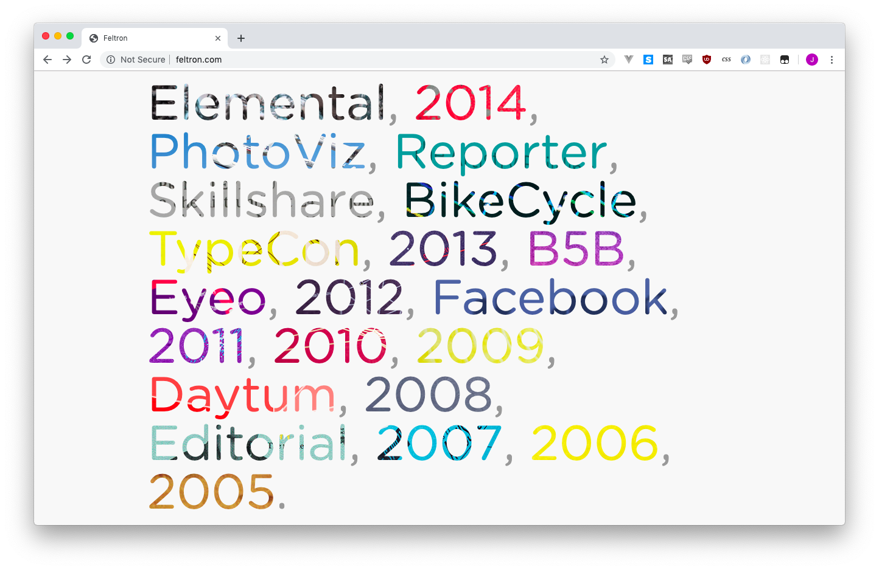

Slide 8
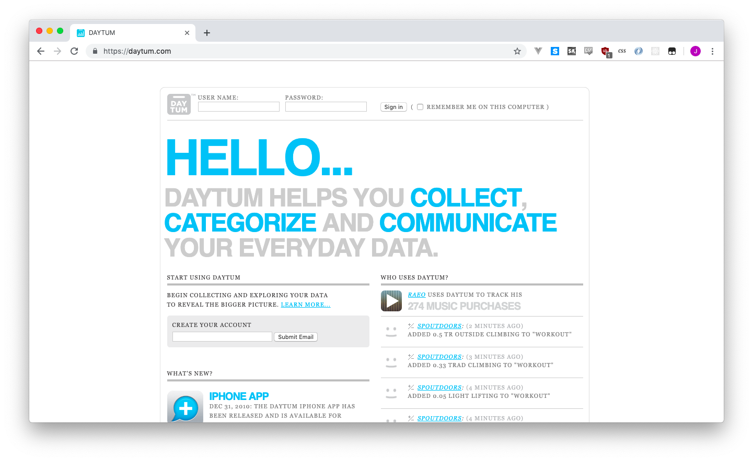

Slide 10
Dear Data
Giorgia Lupi and Stefanie Posavec
dear-data.com

Slide 14
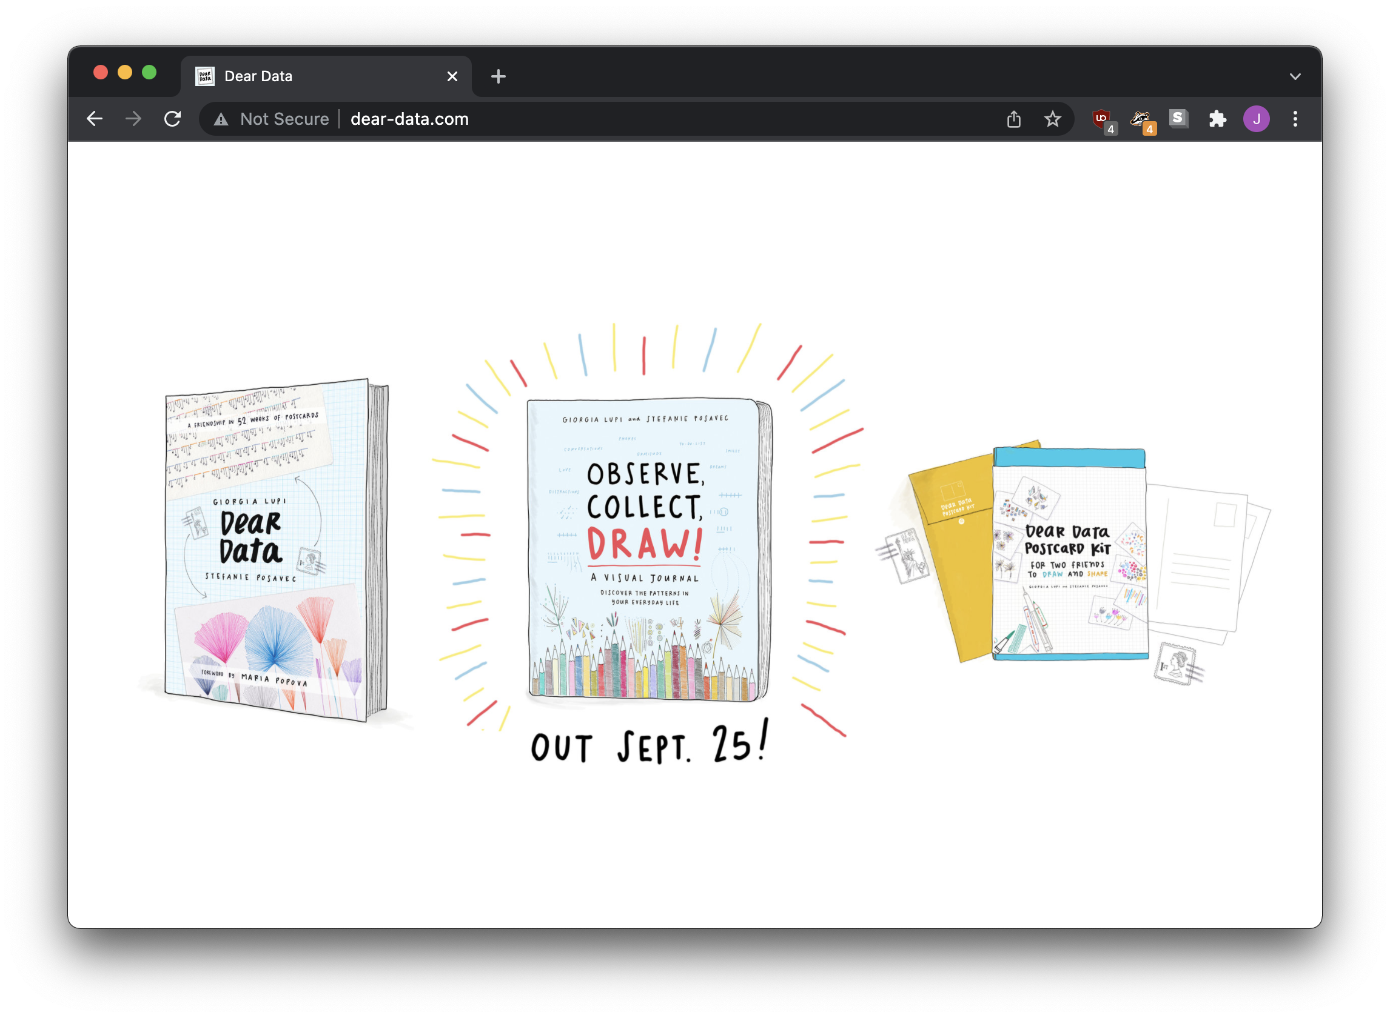

Slide 15
What’s the point?
In this case, maybe art vs information? Why or why not?

Slide 16
Everything should be on purpose.
Every drop of ink should have a reason.
Every color should have a story.

Slide 18
DATA IS THE ENEMY
…THE MORE DATA YOU SHOW,
THE LESS INFORMATION THE USER CAN SEE

Slide 20
FOCUS
what should the reader pay attention to?

Slide 21
SMALL DATA
vs
LARGE DATA
…Don't let your user get distracted

Slide 22
Cats
DOGS

Slide 23
RATS
Cats
DOGS
MICE

Slide 24
BIRDS
OWLS
RATS
Cats
DOGS
MICE
TIGERS
LIONS
BUGS

Slide 26
DIRECT FOCUS TO what's important

Slide 27
BIRDS
OWLS
RATS
Cats
DOGS
MICE
TIGERS
LIONS
BUGS

Slide 28
BIRDS
OWLS
RATS
Cats
DOGS
MICE
TIGERS
LIONS
BUGS

Slide 29
PETS
NOT PETS
BIRDS
OWLS
RATS
Cats
DOGS
MICE
TIGERS
LIONS
BUGS

Slide 30
MORE NUMBERS HERE, too
TEN
TWENTY
THIRTY
FORTY
FIFTY
SIXTY
SEVENTY

Slide 31
MORE NUMBERS HERE, too
TEN
TWENTY
THIRTY
FORTY
FIFTY
SIXTY
SEVENTY

Slide 32
SOMETHING
MORE NUMBERS HERE, too
SOMETHING
TEN
TWENTY
THIRTY
FORTY
FIFTY
SIXTY
SEVENTY

Slide 33
MORE NUMBERS HERE, too
"BACKGROUND"
DATA WITH GREY
TEN
TWENTY
THIRTY
FORTY
FIFTY
SIXTY
SEVENTY

Slide 34
MORE NUMBERS HERE, too
VISUALLY GROUP
SIMILAR DATA POINTS
TEN
TWENTY
THIRTY
FORTY
FIFTY
SIXTY
SEVENTY

Slide 35
MORE NUMBERS HERE, too
DON'T DO THIS
TEN
TWENTY
THIRTY
FORTY
FIFTY
SIXTY
SEVENTY

Slide 36
MORE NUMBERS HERE, too
INSTEAD Do this
TEN
TWENTY
THIRTY
FORTY
FIFTY
SIXTY
SEVENTY

Slide 37
MORE NUMBERS HERE, too
TEN
TWENTY
THIRTY
FORTY
FIFTY
SIXTY
SEVENTY

Slide 38
KEEPING
YOUR LINES
IN LINE
…SHOW YOUR USER ONLY WHAT THEY NEED TO KNOW.

Slide 40
DO YOU NEED TO KNOW exactly where each point is?

Slide 41
DO YOU NEED TO KNOW exactly WHAT each VALUE is?

Slide 42
DO YOU NEED TO KNOW EVERYTHING?

Slide 43
HIDE YOUR GUIDE LINES TO SIMPLIFY

Slide 44
ALTERNATIVE: WHITE OVER GREY

Slide 47
MATCH YOUR LINES AND YOUR DOTS

Slide 48
mATCH YOUR LINES AND YOUR DOTS

Slide 49
NOTE
HERE IS ANOTHER NOTE
HERE IS A NOTE
mATCH YOUR LINES AND YOUR DOTS

Slide 52
ZOOM OUT UNTIL YOUR LINE IS NICE
WEEKLY, NOT HOURLY

Slide 53
ZOOM OUT UNTIL YOUR LINE IS NICE
WEEKLY, NOT HOURLY

Slide 54
BEAUTIFUL LEGENDS
…SIMPLIFY, SIMPLIFY, SIMPLIFY

Slide 55
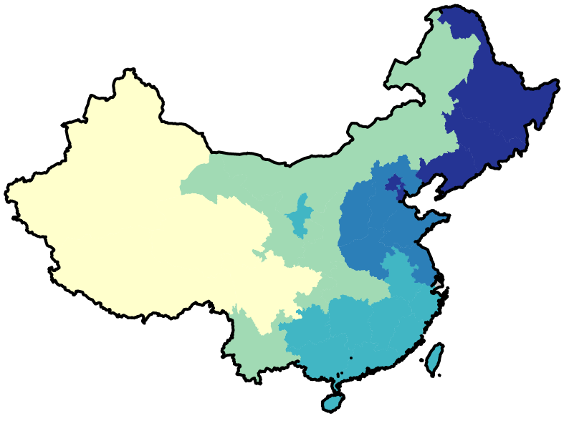
0-22
22-38.4
38.5-60
60.11-87
87.1-100

Slide 56
0-22
22-38.4
38.5-60
60.11-87
87.1-100

Slide 57
0-20
21-40
ROUND OFF
TO "REAL"
NUMBERS
41-60
61-80
81-100

Slide 58
0
20
MARK BOUNDS,
NOT RANGES
40
60
80
100

Slide 59
NUMERIC SCALES GO HORIZONTAL
0
20
40
60
80
100

Slide 60
TOO MANY OUTLINES ARE UGLY
0
20
40
60
80
100

Slide 61
DO YOU NEED EVERY NUMBER?
20
40
60
80
0
100

Slide 62
DO YOU NEED EVERY COLOR?
20
40
60
80
0
100
(these are ugly, I hate them)

Slide 63
BAR AND COLUMN GRAPHS
…ARE SIMPLE TO MAKE AND SIMPLE TO IMPROVE

Slide 64
LONG LABELS + VERTICAL COLUMNS = CLUTTERED
VERY LONG LABEL
VERY LONG LABEL
VERY LONG LABEL
VERY LONG LABEL
VERY LONG LABEL
VERY LONG LABEL
VERY LONG LABEL
VERY LONG LABEL
VERY LONG LABEL
VERY LONG LABEL
VERY LONG LABEL
VERY LONG LABEL
VERY LONG LABEL
VERY LONG LABEL
VERY LONG LABEL
VERY LONG LABEL
VERY LONG LABEL
VERY LONG LABEL
VERY LONG LABEL

Slide 65
LONG LABELS GET HORIZONTAL BARS
A VERY VERY VERY LONG LABEL
MANY MANY WORDS CAN BE HERE
AN EASY-TO-READ LABEL
ANOTHER EASY-TO-READ LABEL
LABEL LABEL LABEL LABEL LABEL

Slide 66
DOGS
BIRDS
CATS
MICE
10
20
30
40
50
60
70
80
90
100
110
120

Slide 67
KEEP YOUR BARS in order
CATS
DOGS
MICE
BIRDS
10
20
30
40
50
60
70
80
90
100
110
120

Slide 68
DIRECTLY LABEL if you have few data points
CATS
120
DOGS
89
MICE
63
BIRDS
48

Slide 69
YOU CAN GO INSIDE, too!
CATS
120
DOGS
89
MICE
63
BIRDS
48

Slide 70
4.5 MEASUREMENTS
MORE NUMBERS HERE, too
3.2 MEASUREMENTS
TEN
TWENTY
THIRTY
FORTY
FIFTY
SIXTY
SEVENTY

Slide 73

Why annotate
What to annotate
When to annotate
How to annotate
important topics

Slide 75
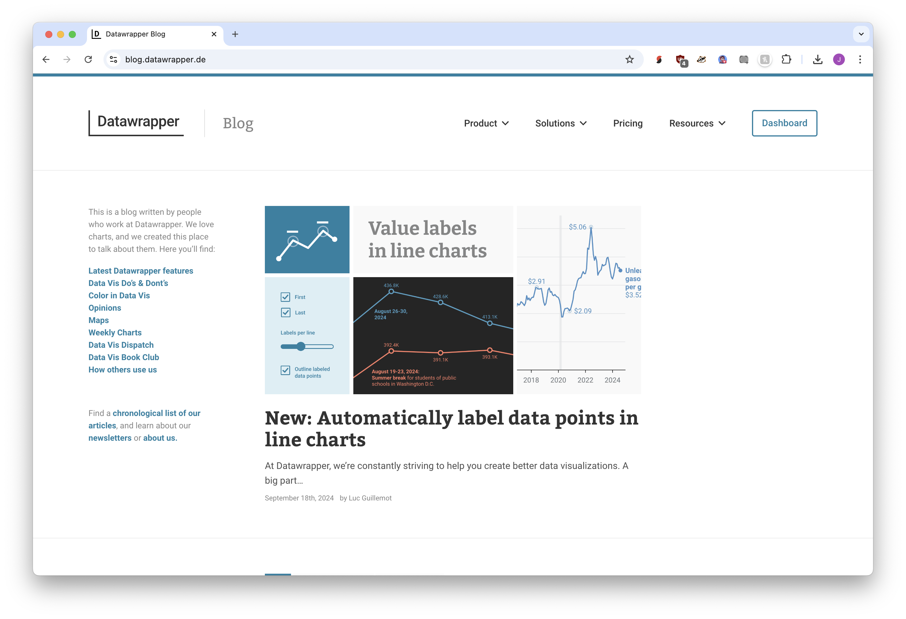
Datawrapper Blog

Slide 76
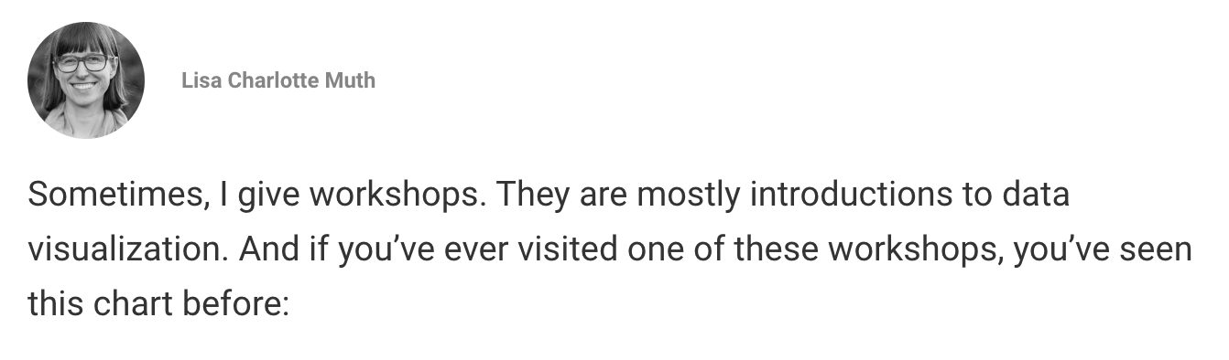
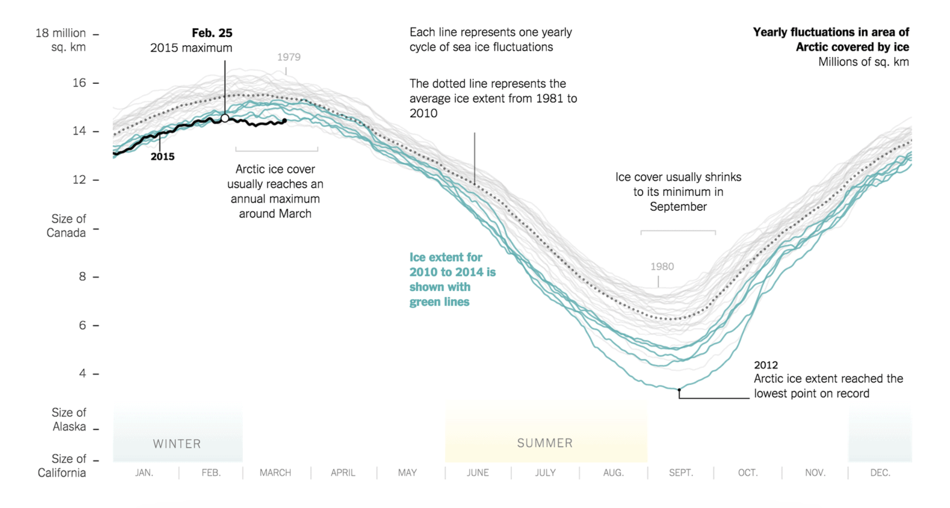
https://blog.datawrapper.de/readers-time/

Slide 77



Why annotate?
For readers: they help them understand the graphic
We talked about color and position to direct attention
Annotations do a better job with slightly less elegance
For you: they force you understand the visual a little better
Just like with titles, you need to determine what’s important
There has to be something worth directing attention to

Slide 78
What to annotate?
Point out data points that you want noticed
Explain why data points look like they do
Explain or support design decisions
Provide specifics or follow-up from title

Slide 79







Point out data points you want noticed

Slide 80
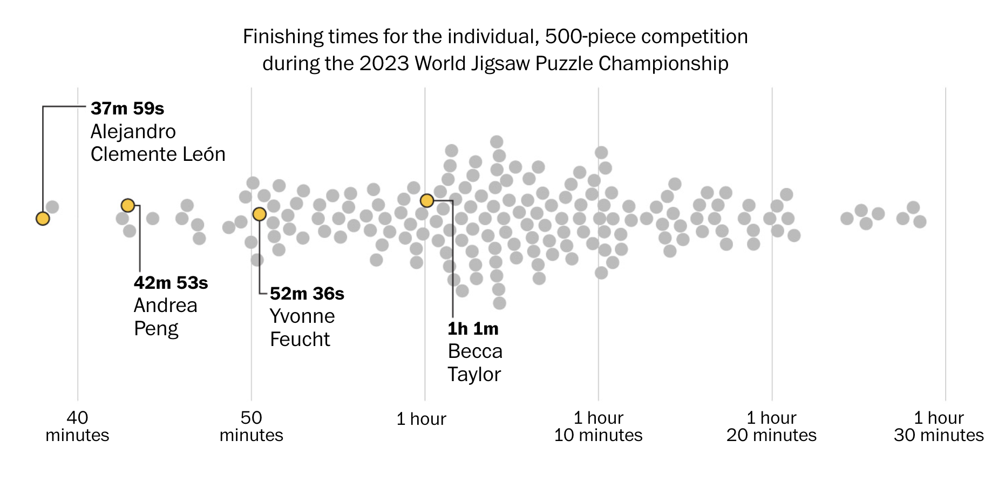
https://www.washingtonpost.com/style/interactive/2024/speed-puzzling-competitions/

Slide 81





Explain why the data looks that way

Slide 82
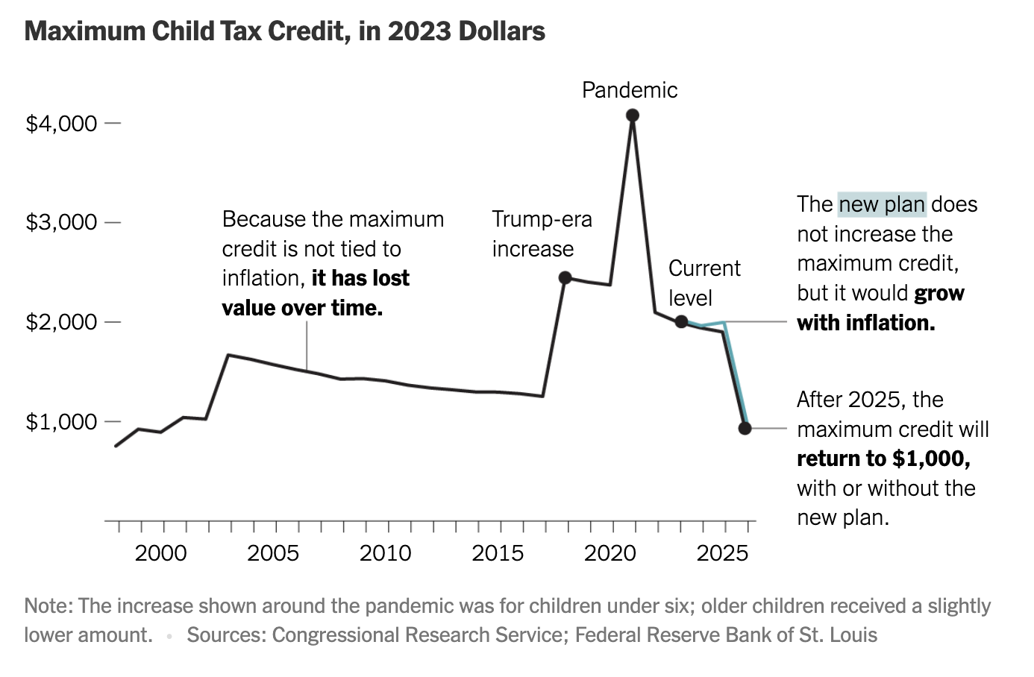
https://www.nytimes.com/2024/01/30/upshot/child-tax-credit-poverty.html

Slide 83









Explain or support design decisions

Slide 84
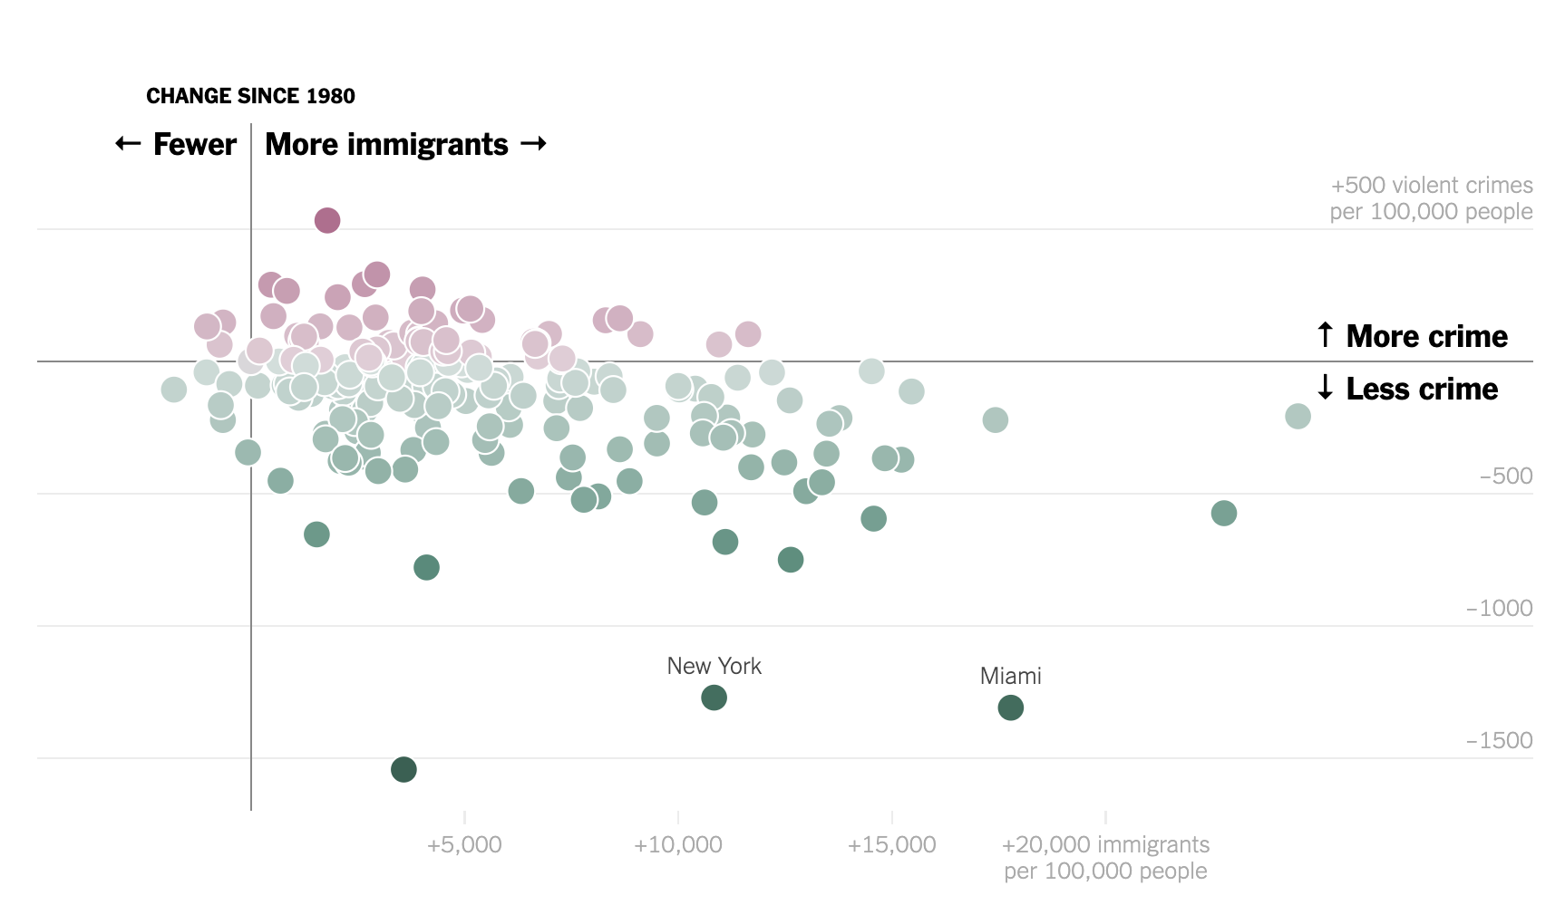
https://www.nytimes.com/interactive/2018/03/30/upshot/crime-immigration-myth.html

Slide 85


Provide specifics or follow-up from title

Slide 86
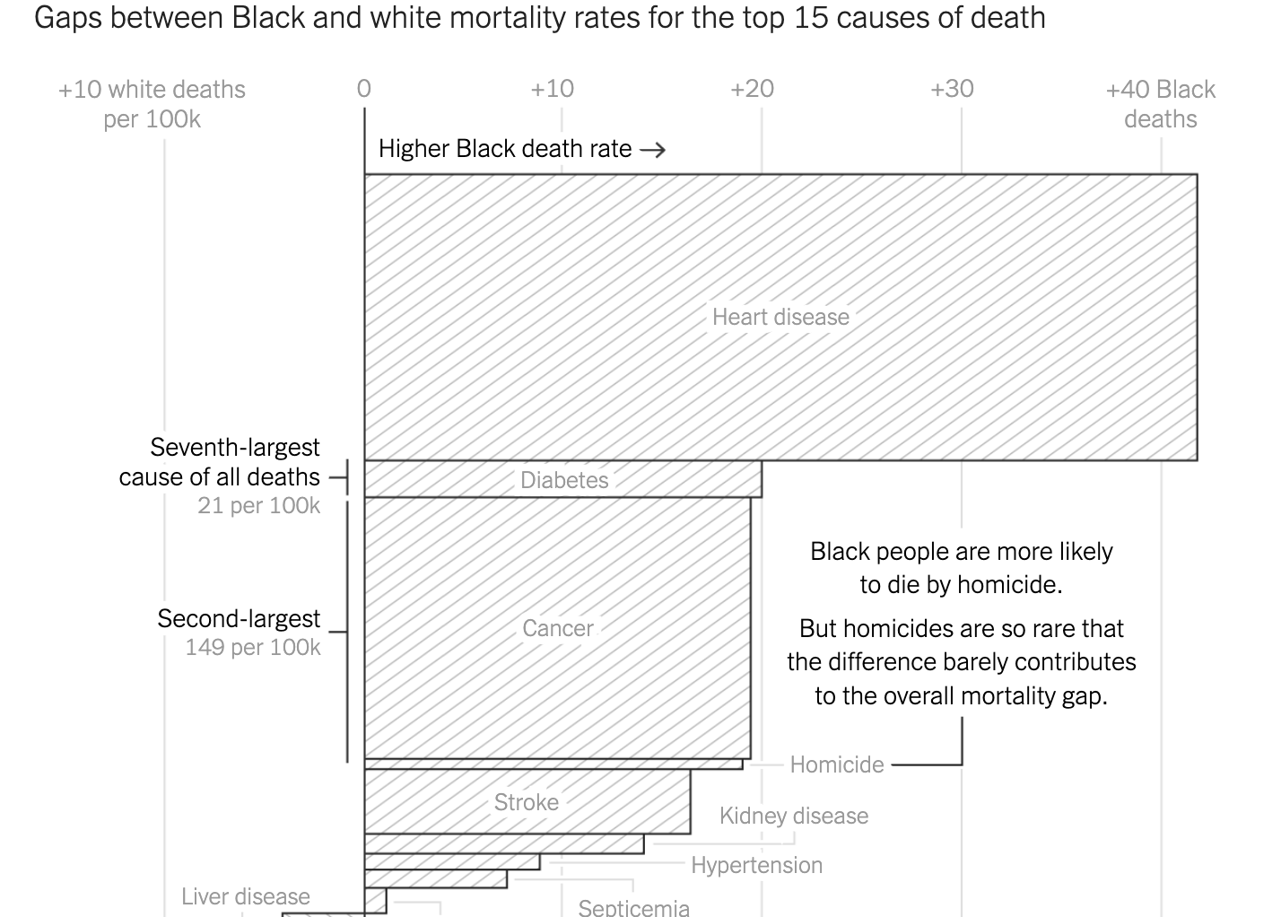
https://www.nytimes.com/interactive/2020/08/11/opinion/us-coronavirus-black-mortality.html

Slide 87
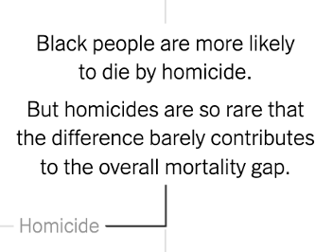
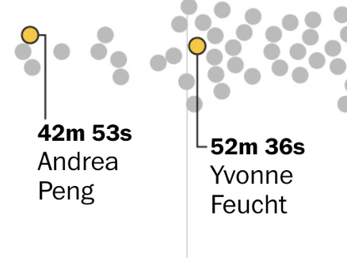
“what that is” vs “why that is”
Here’s what this data point is: Texas
Here’s why this data point is here: Texas has a lot of cattle farms
A little bit of both: Texas, 4lb
You’re deciding between narrative or data-driven (either is fine!)

Slide 88






When to annotate
Complicated graphics?
No, you should probably just split them up
Annotations are not an excuse for lack of curation
I bet every one of your visuals could be 2-3 smaller graphics
But sure, okay, annotate it, it’ll help
Simple graphics?
Honestly, you can annotate anything
Provides a “thought about” or “lived in” a feel

Slide 89
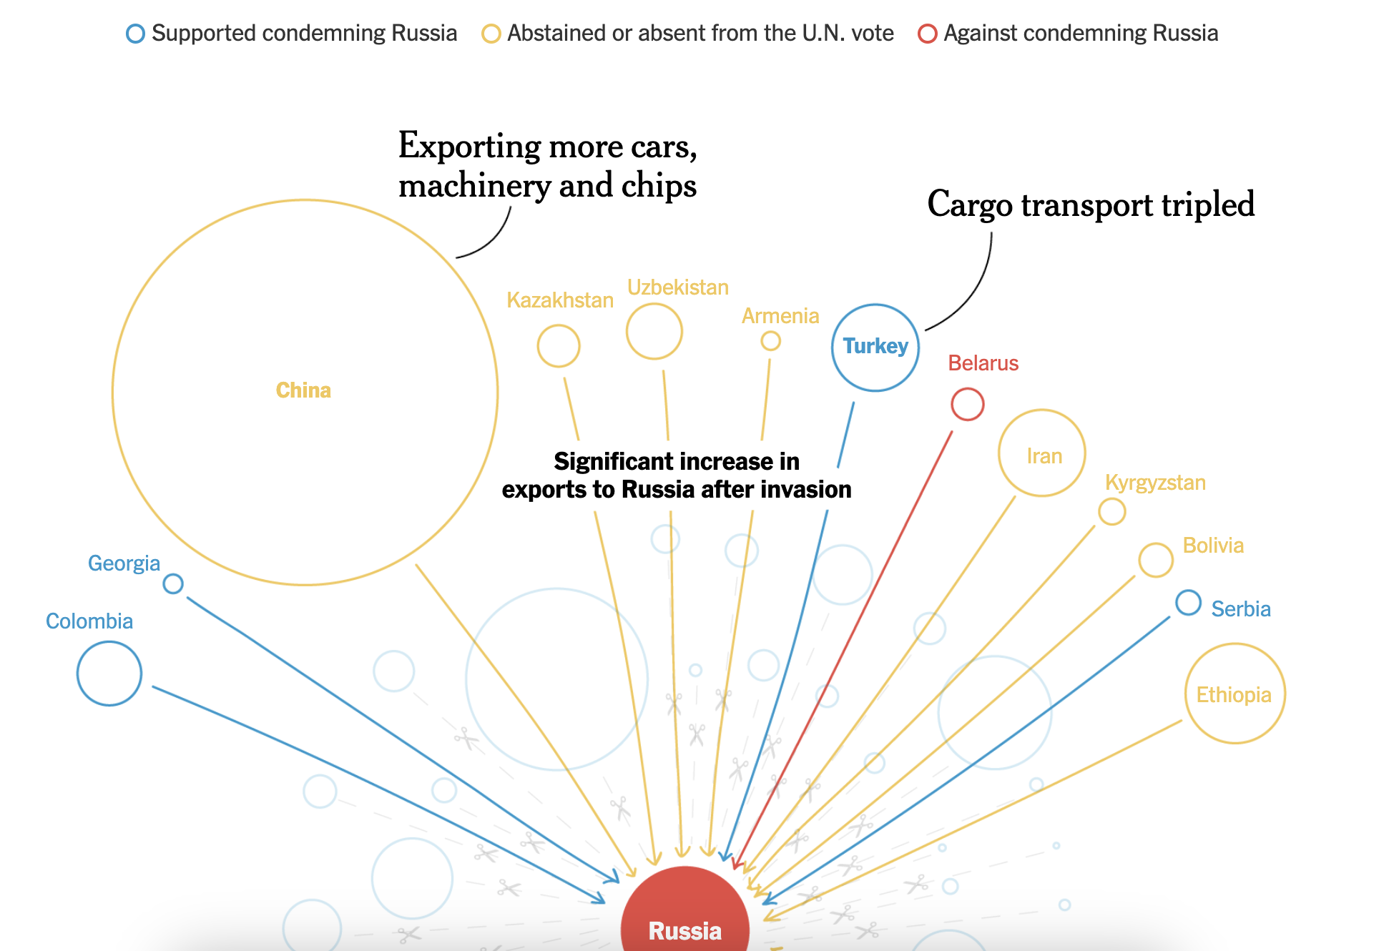
https://www.nytimes.com/interactive/2023/12/11/upshot/nighttime-deaths.html

Slide 90
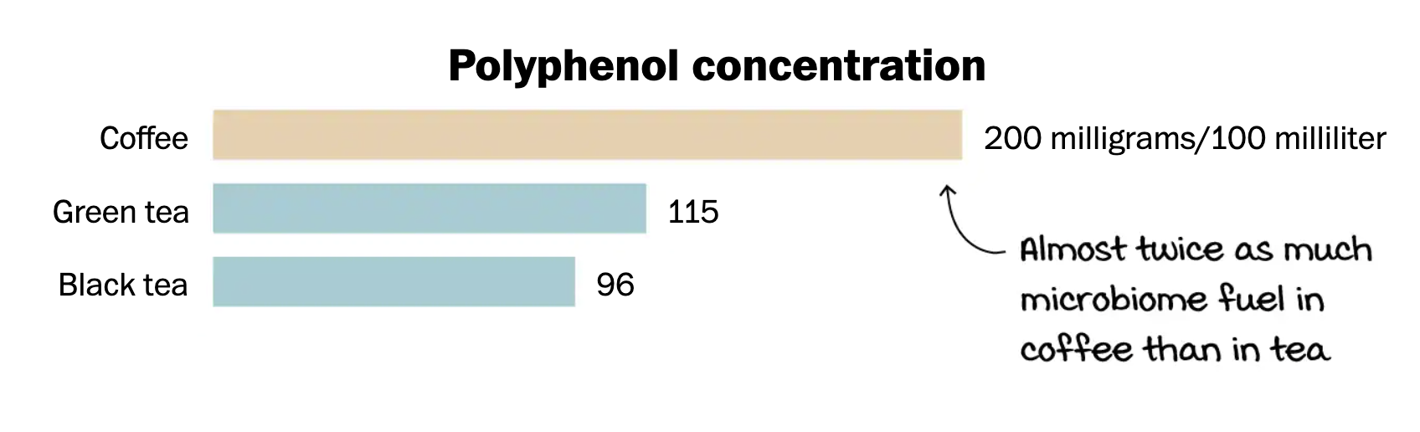
https://www.washingtonpost.com/wellness/interactive/2022/coffee-vs-tea-nutrition-health/

Slide 91
How to annotate
Flourish: Use the pencil icon - details here
Datawrapper: Annotations tab – details here
Bonus: you can also use them to add measurement types for axes
Altair: mark_text (potentially with transform_filter)
A few links at https://jonathansoma.com/everything/visuals/annotations/

Slide 92
Bonus wisdom
Annotations are the primary reason why you move away from tooling

Slide 93
https://blog.datawrapper.de/readers-time/

Slide 95
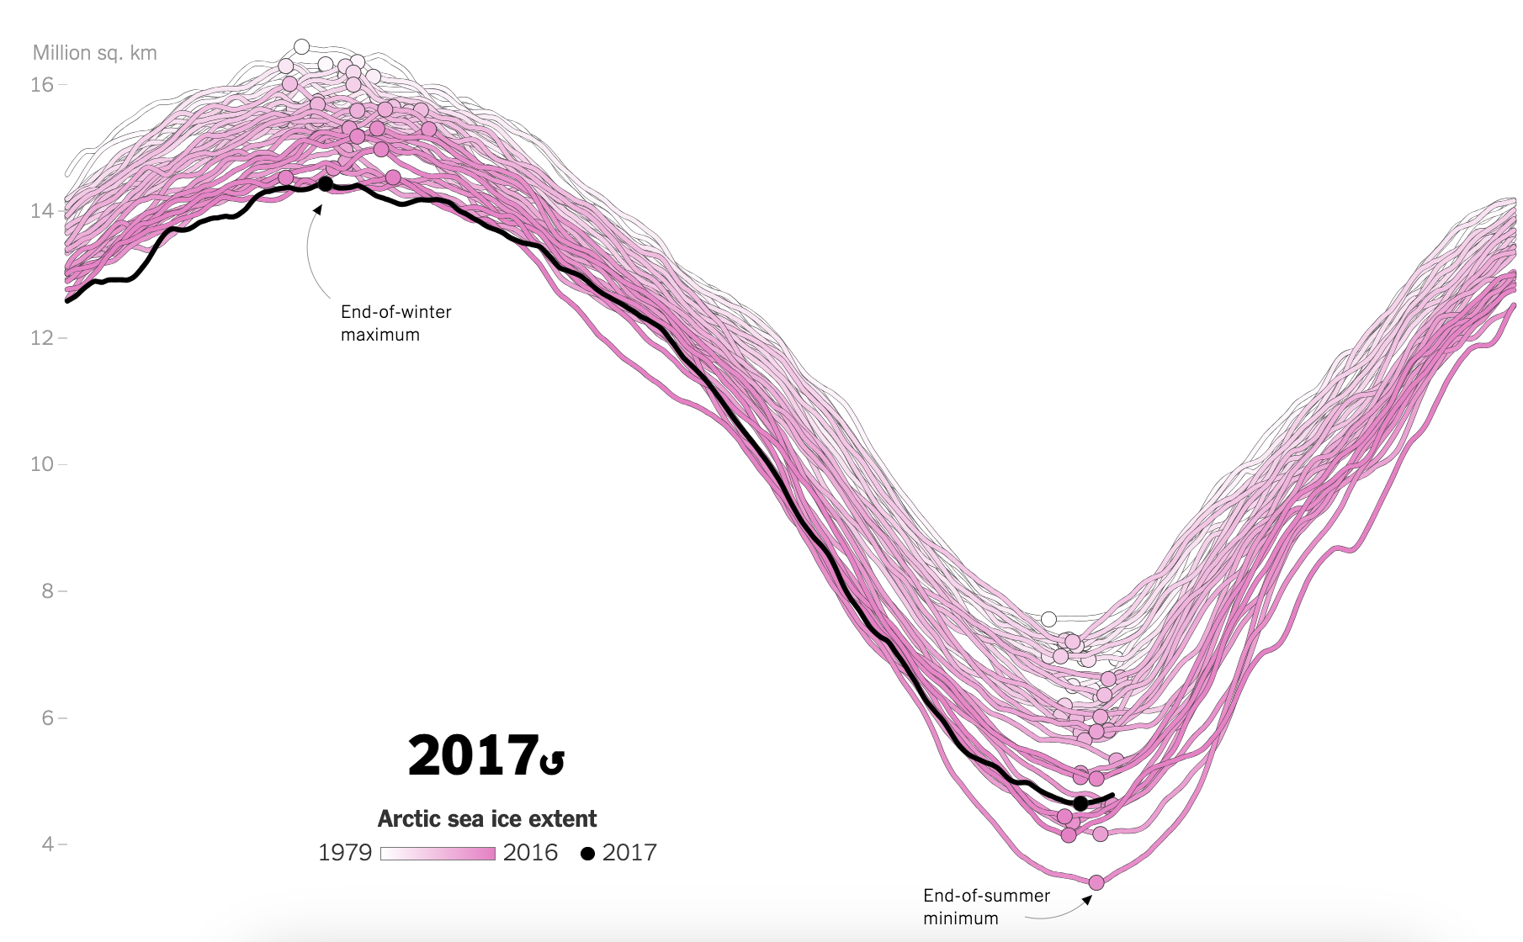
https://www.nytimes.com/interactive/2017/09/22/climate/arctic-sea-ice-shrinking-trend-watch.html

Slide 96
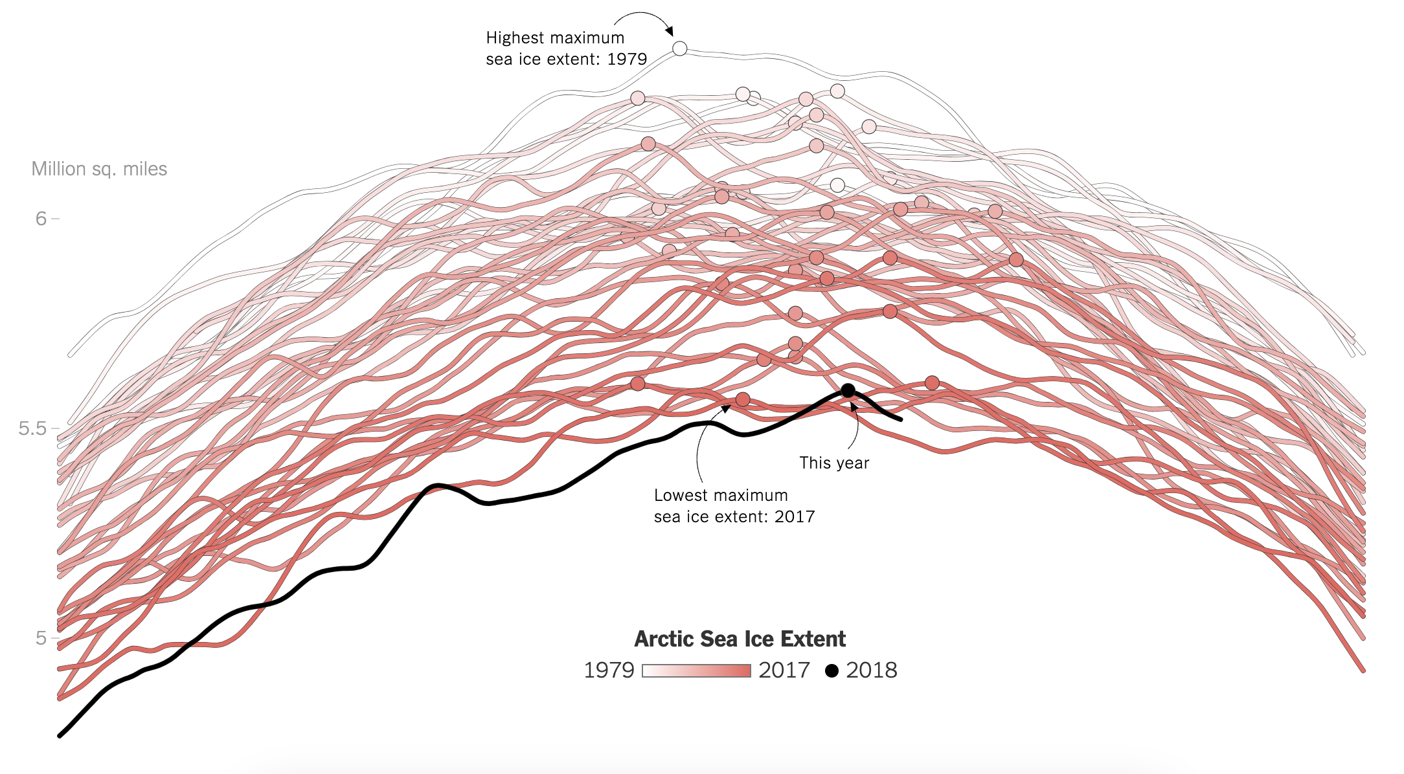
https://www.nytimes.com/interactive/2018/03/23/climate/arctic-ice-maximum.html

Slide 97
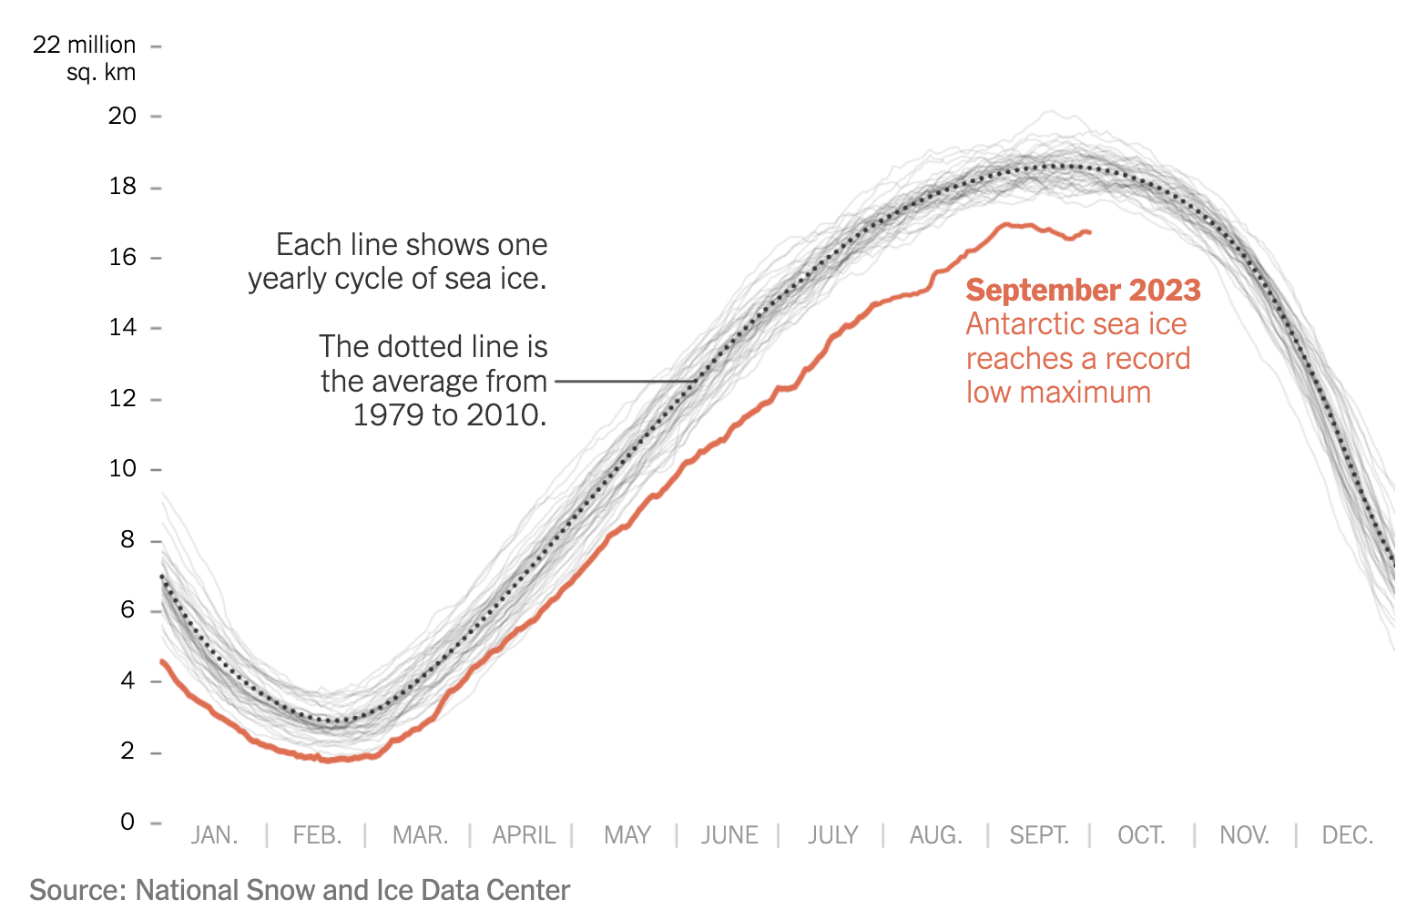
https://www.nytimes.com/2023/10/04/climate/antarctic-sea-ice-record-low.html

Slide 98

Why annotate
What to annotate
When to annotate
How to annotate
today’s topics

Slide 100
What would you do?

Slide 101
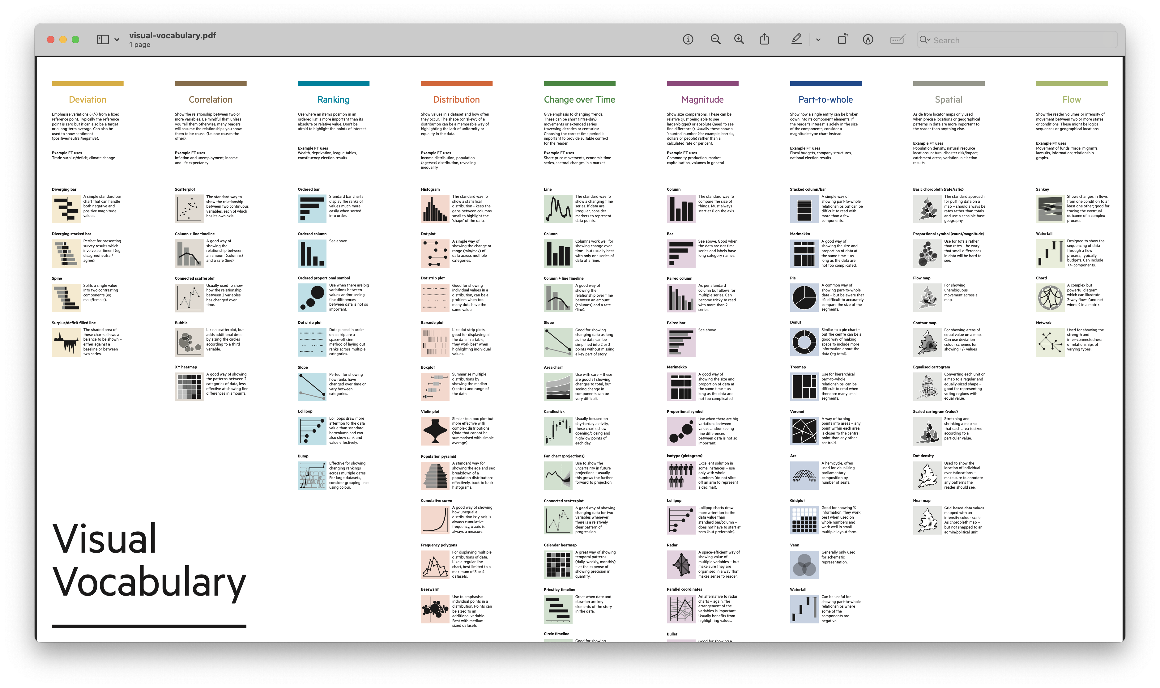

Slide 102
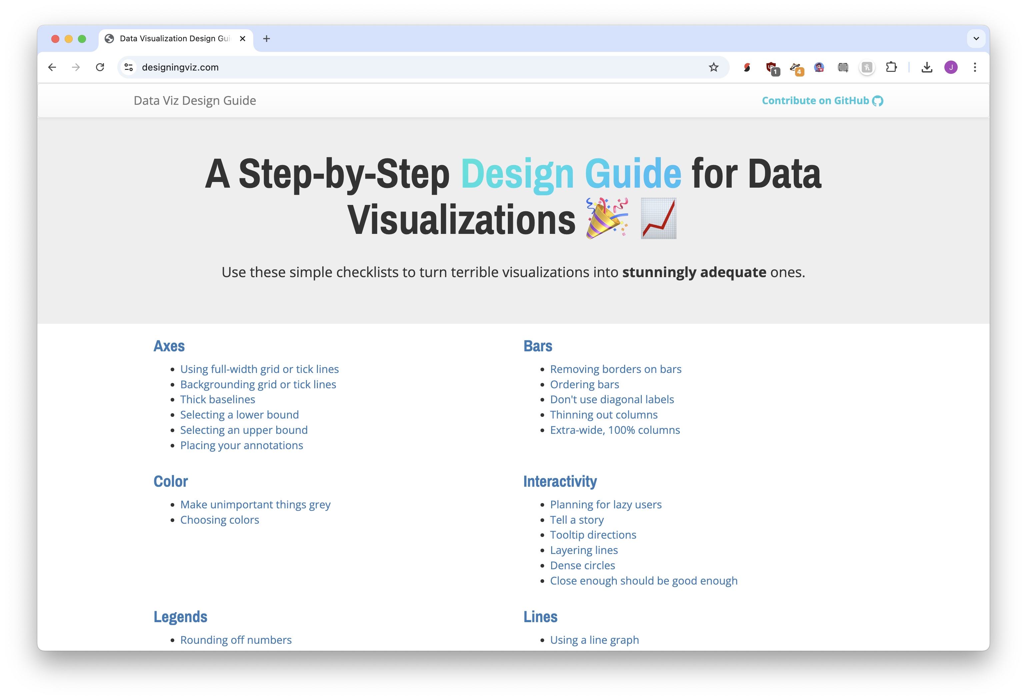
designingviz.com

Slide 103
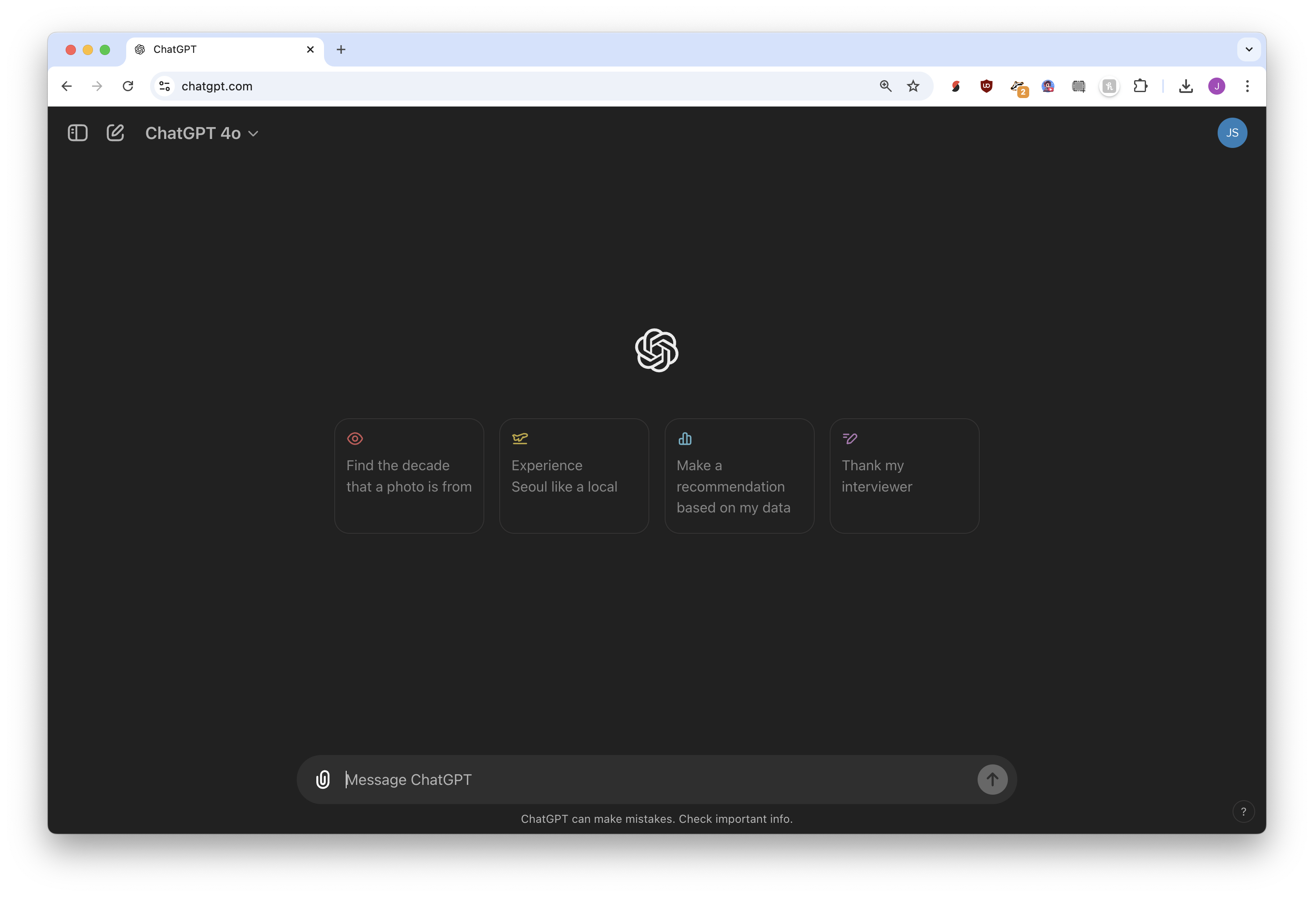


Slide 104
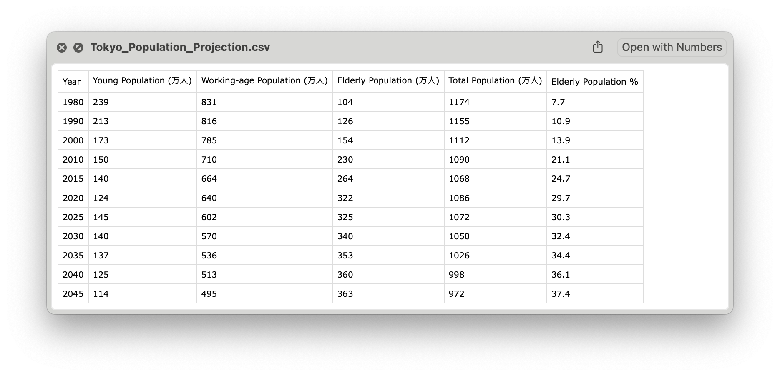

Slide 105
Copy the image into ChatGPT, and ask for a table of data

Slide 106

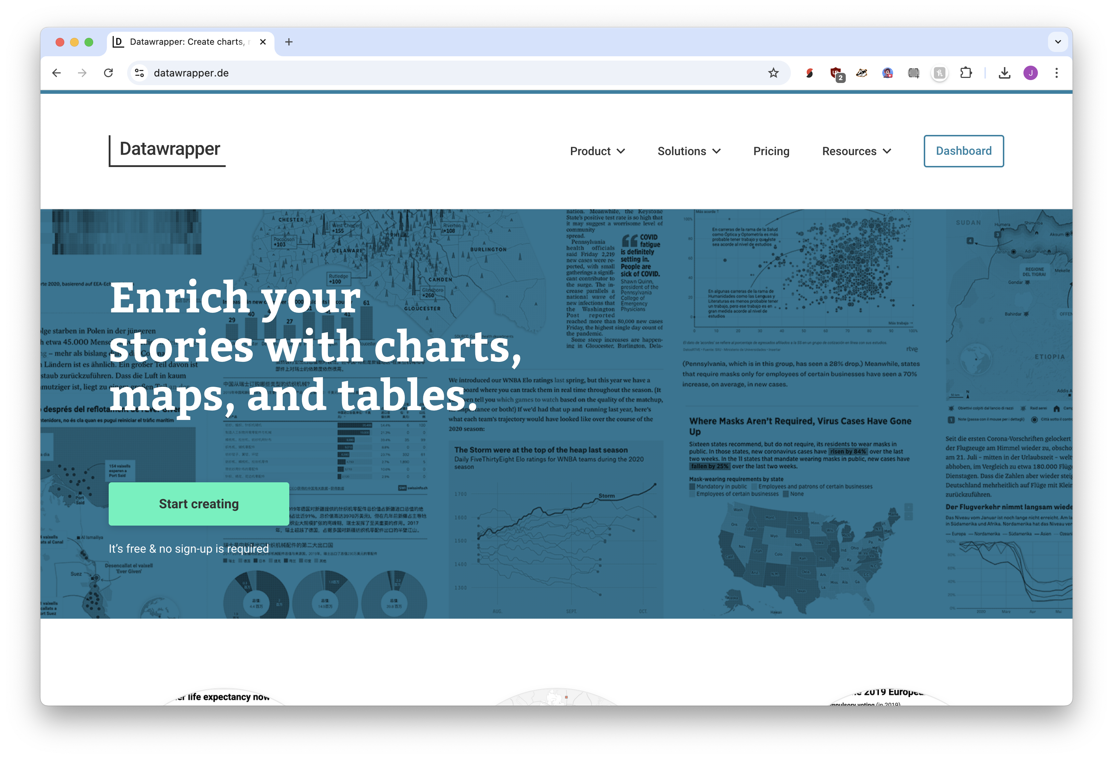
Datawrapper
Flourish

Slide 108
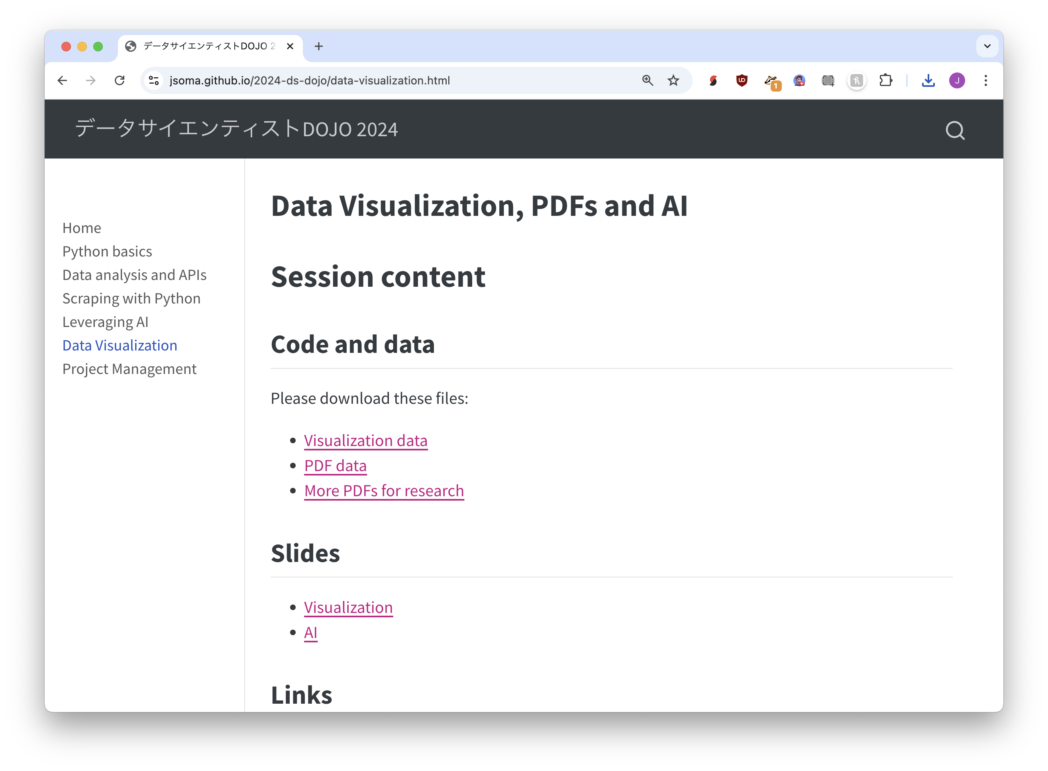


② Download the PDF data file
① Visit https://bit.ly/ds-dojo-2024,
Click Data Visualization

